Slide 1
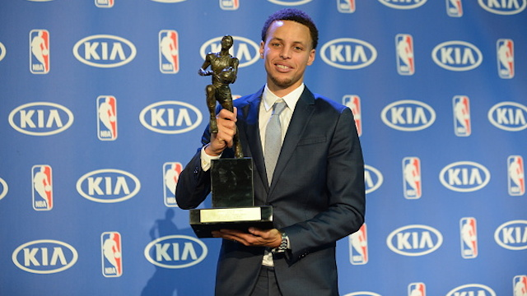
Predicting the 2017 NBA Most Valuable Player Award
DS-SEA-06
Taylor Rands

Slide 2

What’s the problem?
In the NBA this year, it is extremely difficult to predict the Most Valuable Player, as there are many potential deserving candidates.
With the recent popularity of advanced statistics, picking one MVP from a group of players with unbelievable statistical seasons has become a challenge.
Main Question: Can we predict the 2017 NBA Most Valuable Player using Logistic Regression and other techniques?

Slide 3
How does one determine the success of the best performing players?
Basic Statistics:
25 Continuous Variables
Points, Rebounds, Assists, etc.
Advanced Statistics:
20 Continuous Variables
Player Efficiency Rating, Value over Replacement Player, Box Score Plus/Minus, etc.
Other Statistics to take note of:
Games played, Team Success, etc.

Slide 4
Where is the data coming from?
Nba.com Statistic Page
There has never been an MVP that has not been on that year’s All Star team
Using the statistics from each All Star player from the 1955-1956 regular season, form a model to determine the 2017 Most Valuable Player
From 1955, there has been 1,447 players in the All Star game. (Including duplicate players)

Slide 5
What’s next?
Data Cleaning
Importation of player’s data while weighing most useful statistics
Implementation of other Data Techniques:
Decision Tree, Random Forests, Confusion Matrix, etc.
Eliminating correlated statistics:
Example: FGs Made, FGs Missed, FG%

Slide 6
Questions or suggestions?
Thank you!

